Slide 1
Marica Reitano matricola: 1000015958
Homework 1

Slide 2
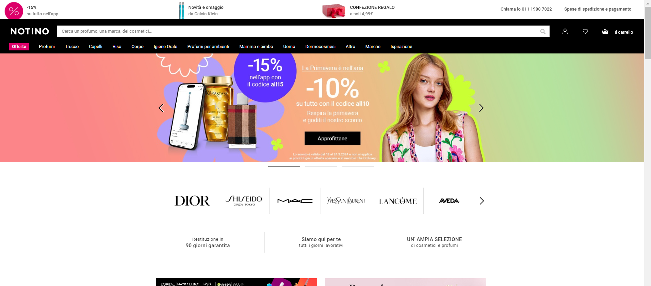
whttps://www.notino.it

Slide 3
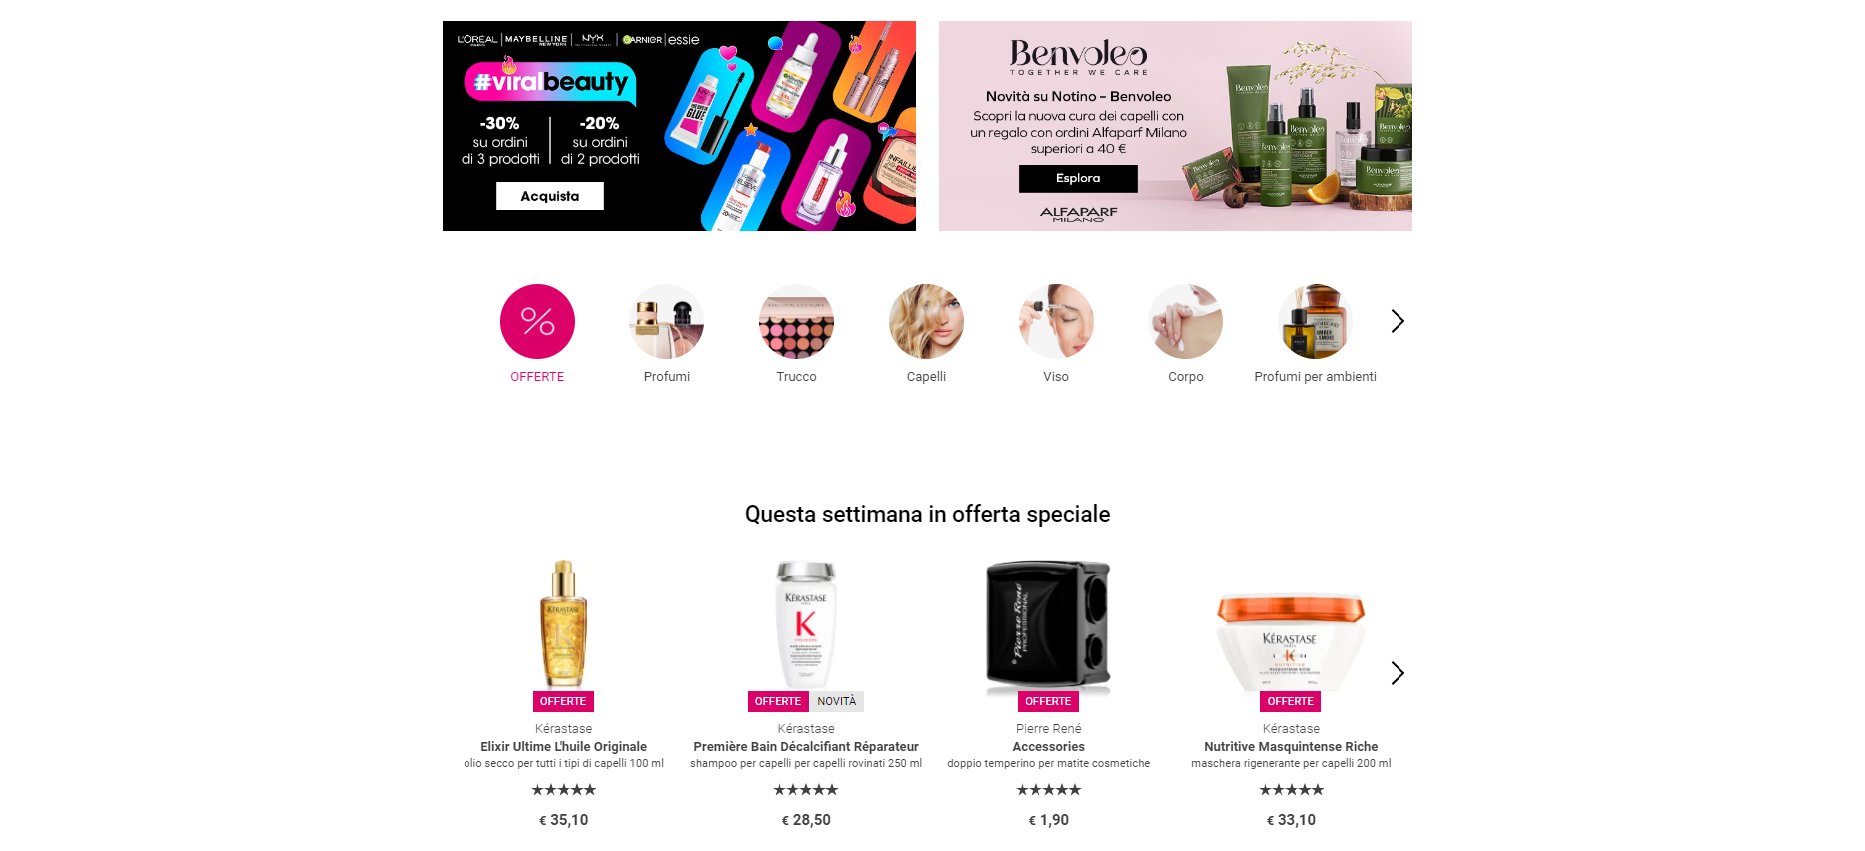

Slide 4
